Slide 1
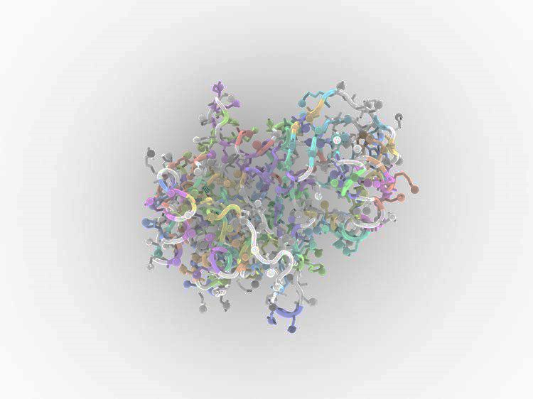

PTI
Protein structure
& inhibitor

Slide 2
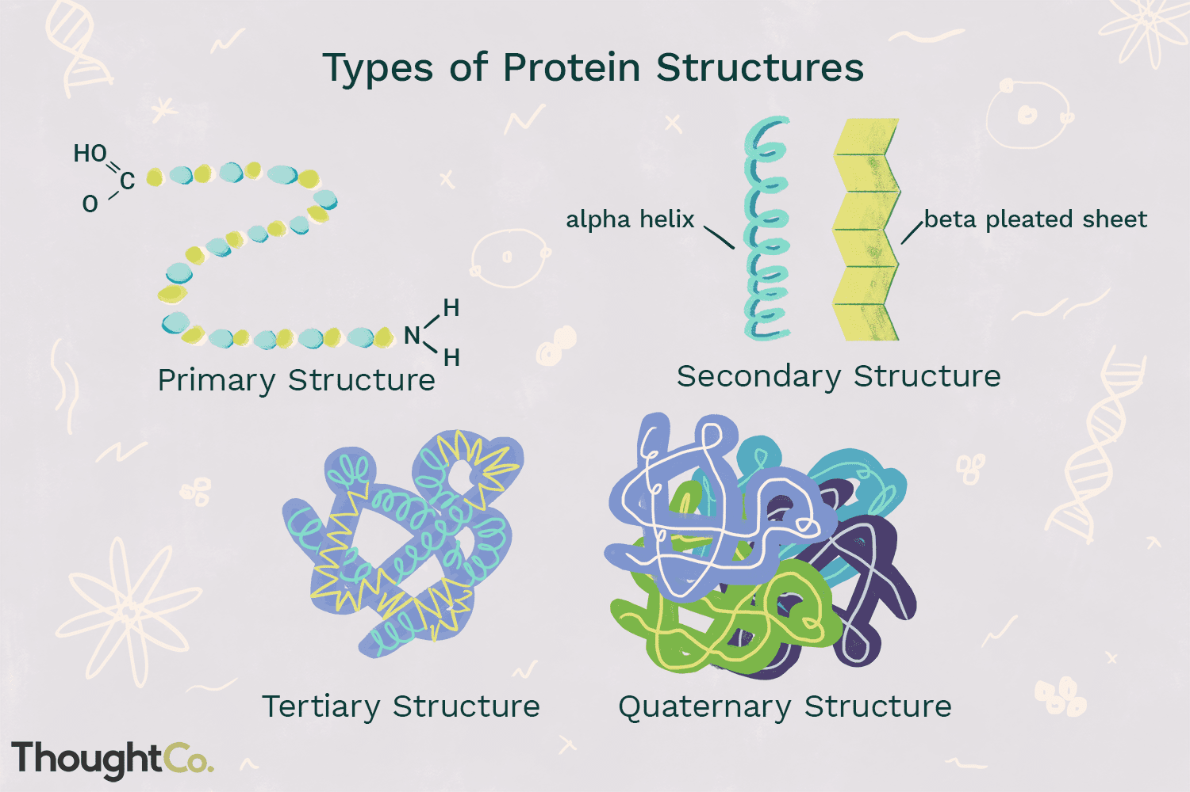
Types of protein structure

Slide 3
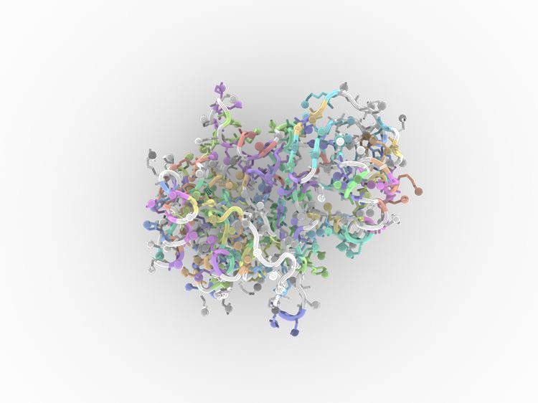
understanding how the protein works
use that information for different purposes
control or modify protein’s function
predict what molecules bind to that protein and understand various biological interactions
assist drug discovery or even design our own proteins.
why Knowledge of protein’s 3D structure is a huge hint ?
Problem

Slide 4

TECHNICAL TOOLS
solution
Computer simulation based on energy calculation
Based on physio-chemical principles
Thermodynamic equilibrium with a minimum free energy
Global minimum free energy of protein surface
Knowledge Based approaches
*Template based:
-Homology Based Approach
-Threading Protein Sequence
*Template free
Ligand-Based Virtual Screening (LBVS)
Molecular Docking

Slide 5
solution
1
2
3
4
5
Homology modelling
Threading or Fold recognition
Template free modelling
(Ab Initio)
LBVS
Molecular Docking

Slide 6
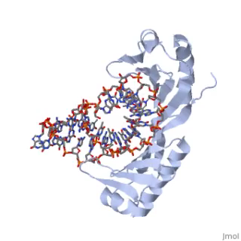

Slide 7
Homology modelling
Target sequence
Template selection
Alignment
Template-target
Backbone generation
Loop modelling
Side chain modelling
Optimization and validation

Slide 8

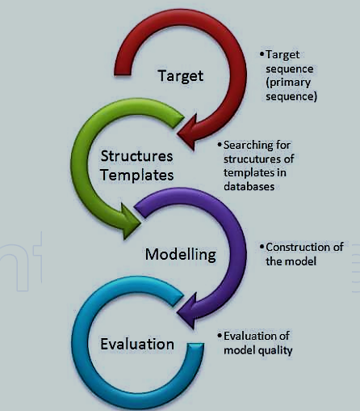
Threading or Fold recognition
modelling

Slide 9
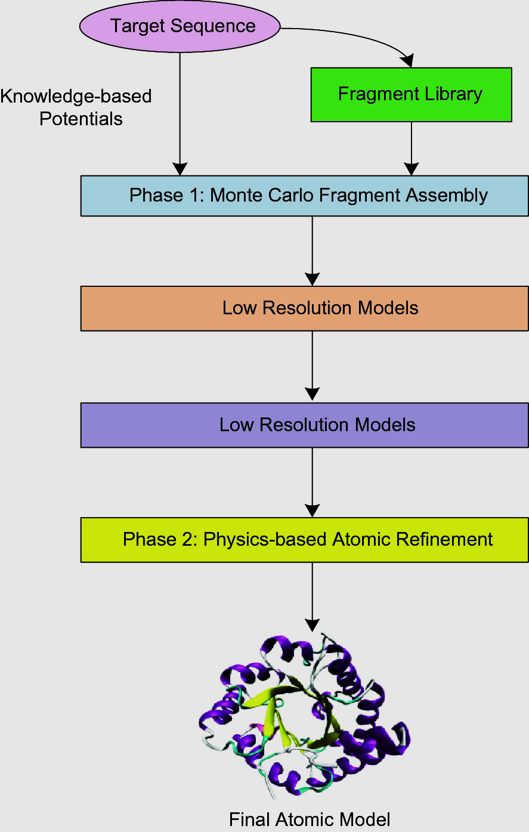
Template free modelling
(Ab Initio)

Slide 10
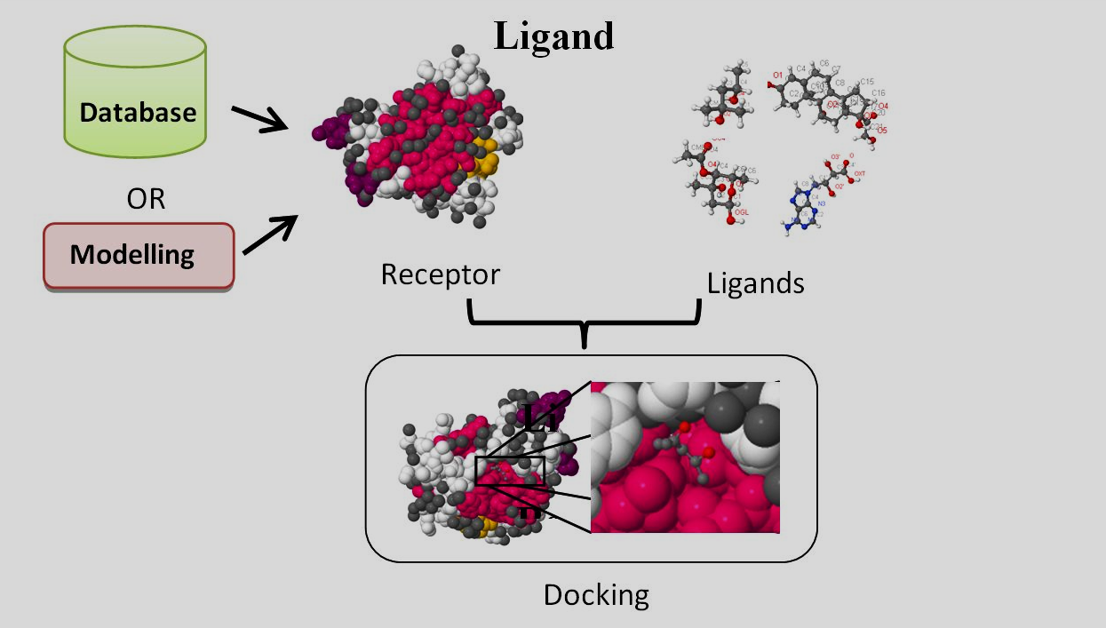

Slide 11
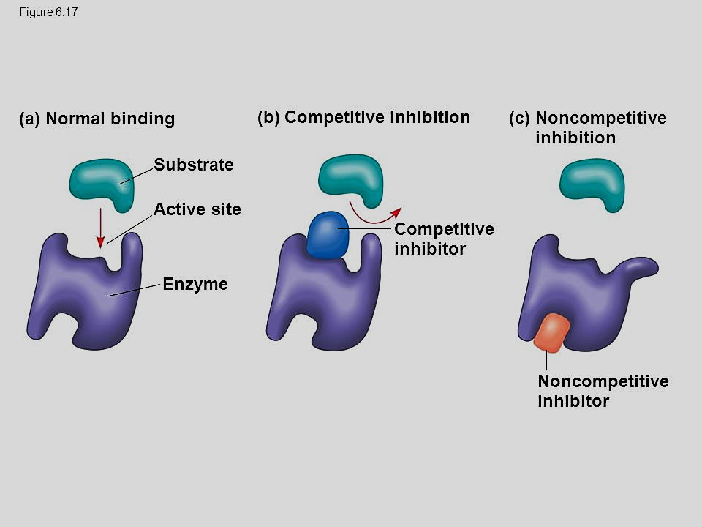
Molecular Docking

Slide 12
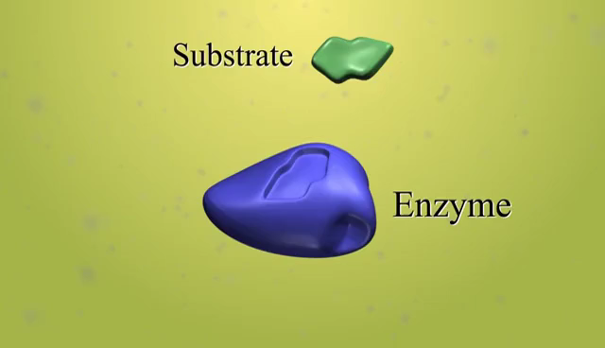

Slide 13
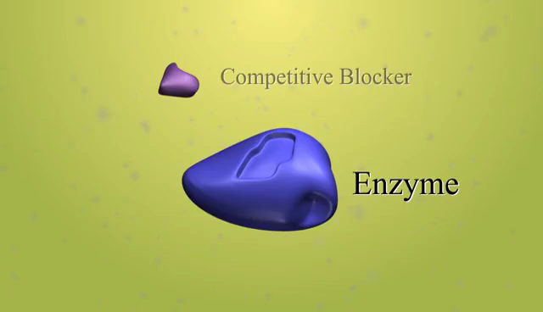

Slide 14
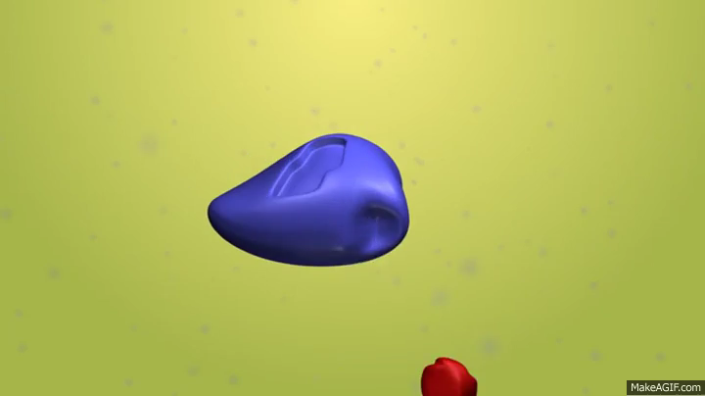

Slide 15
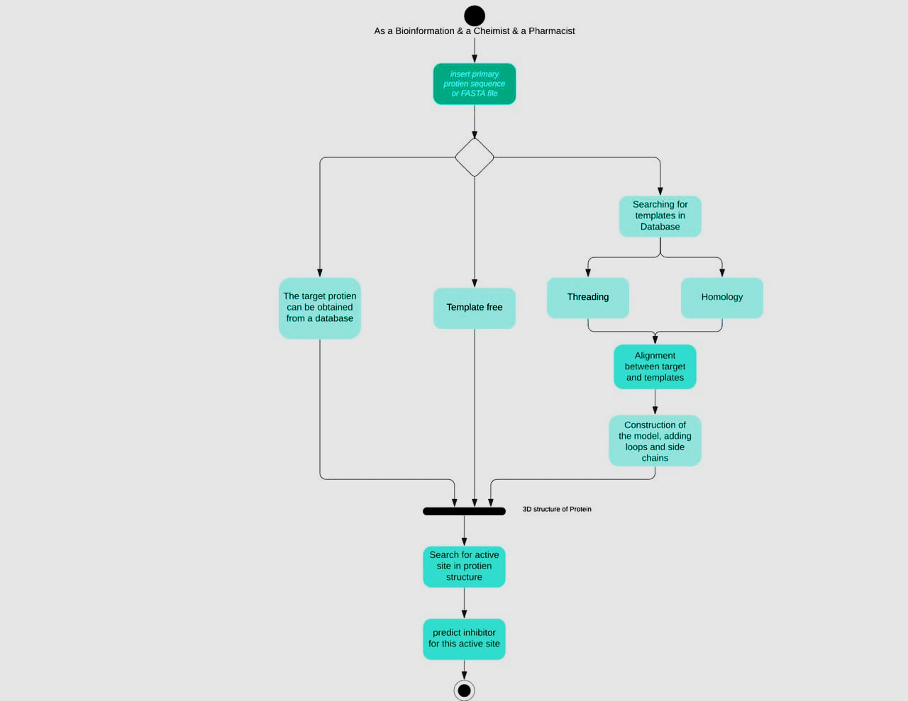
Activity diagram

Slide 16
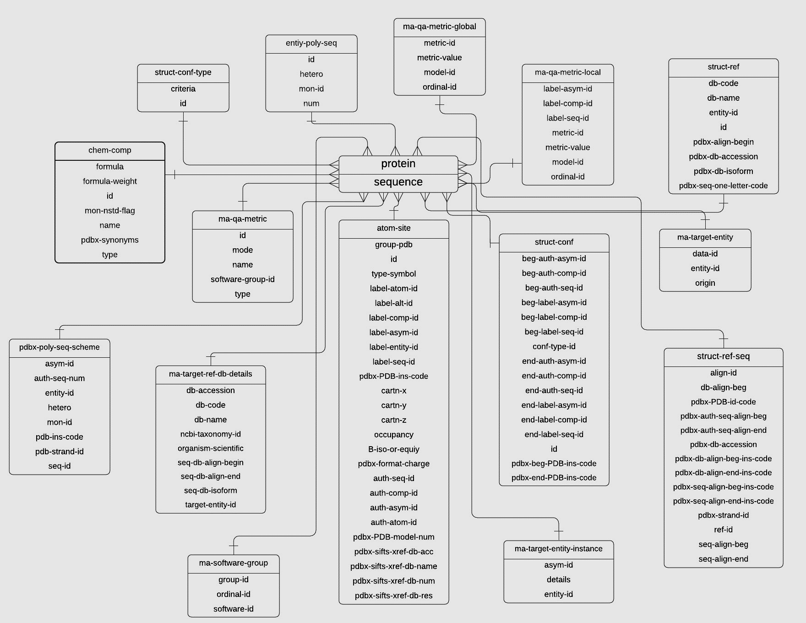
DB diagram

Slide 17
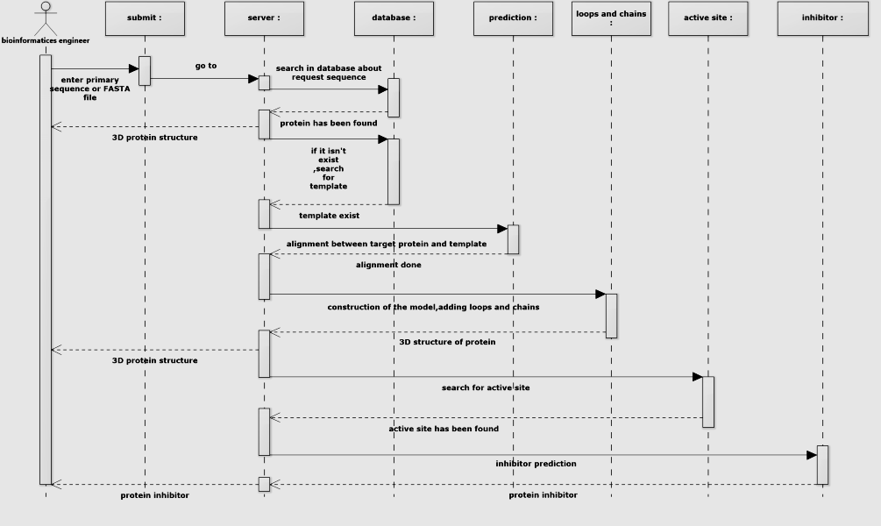
Sequence diagram

Slide 18
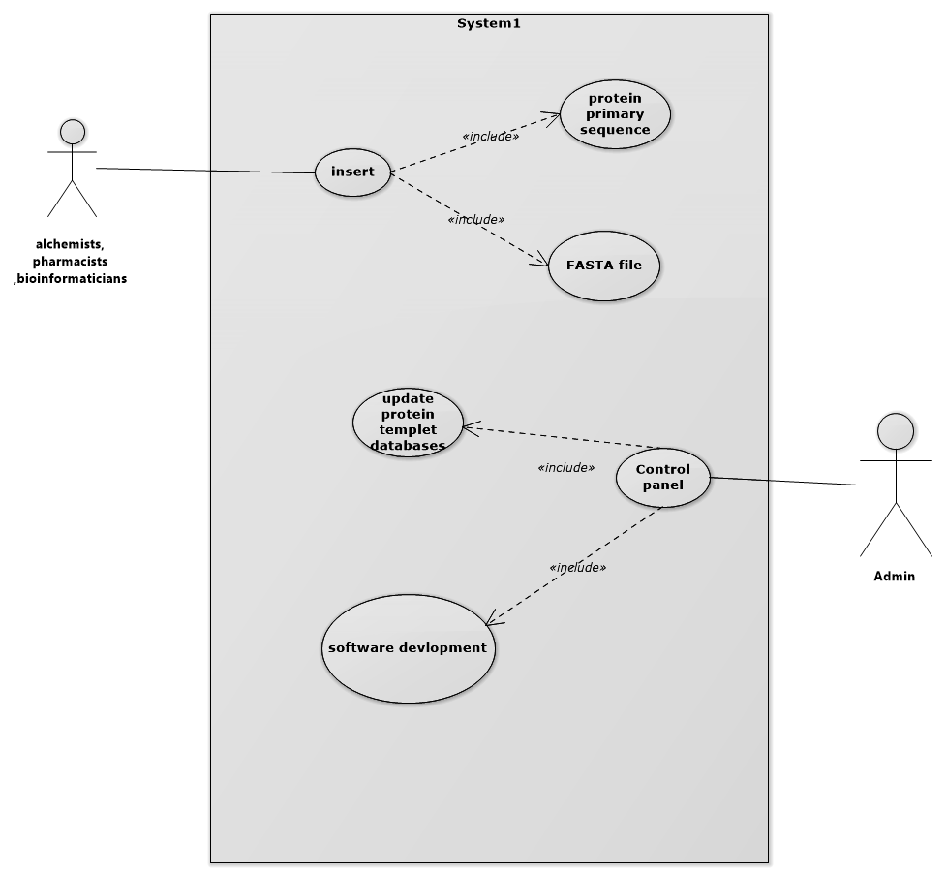
Use case diagram
Alchemists,
Bioinformatician,
pharmacists
Admin

Slide 19
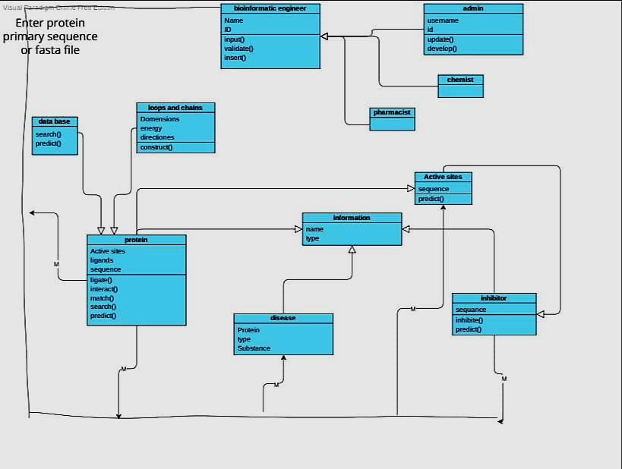
Class diagram

Slide 20
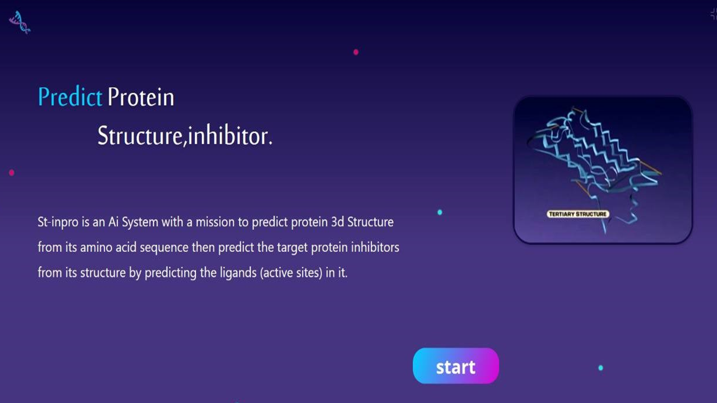
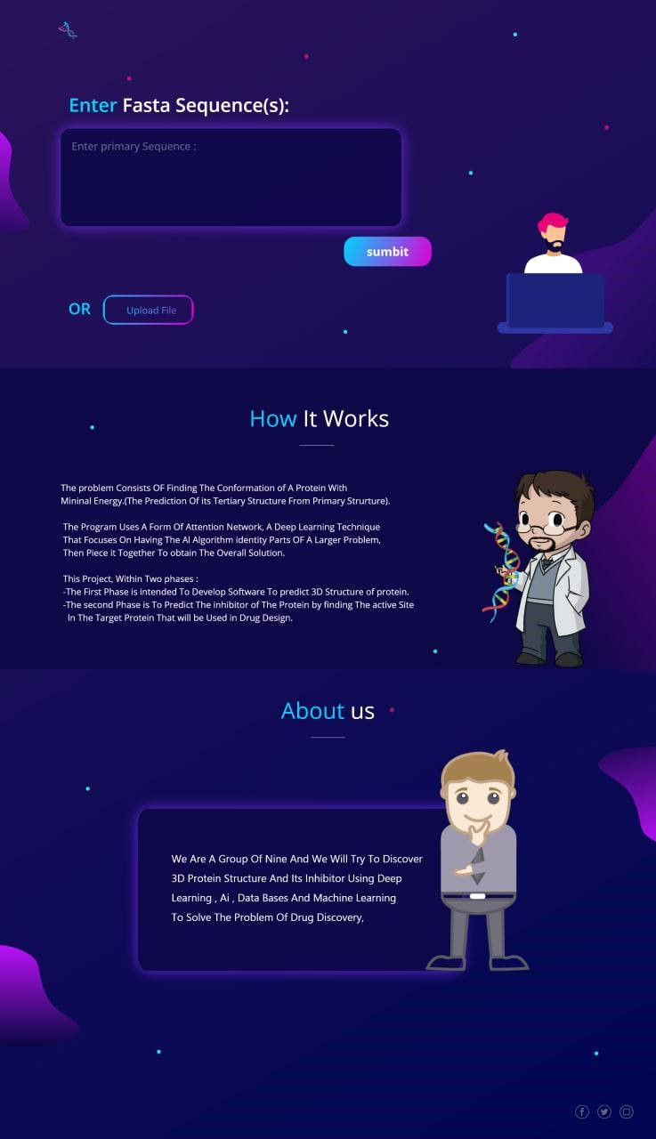
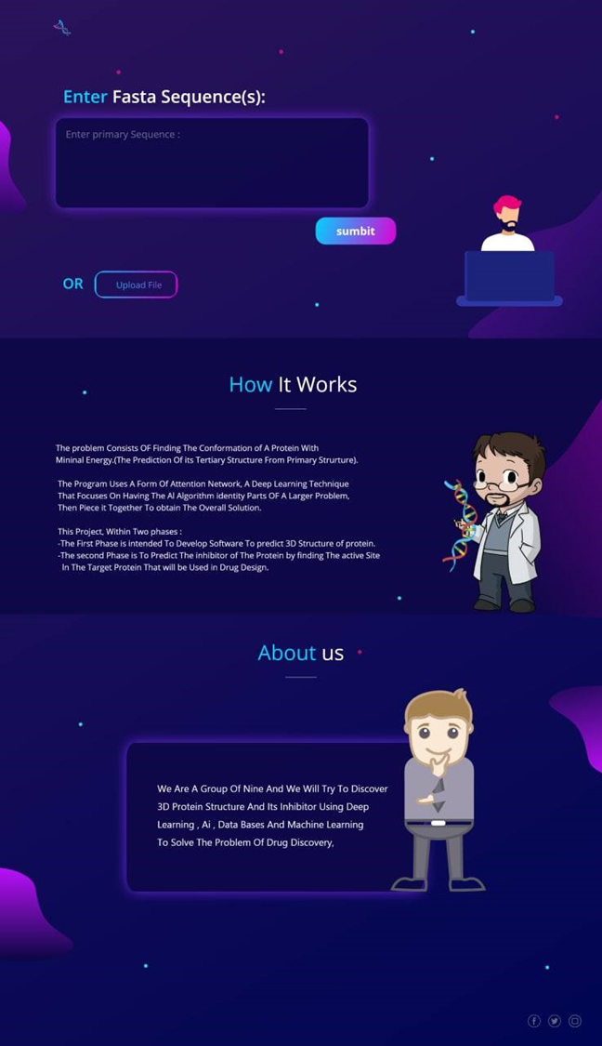

Slide 21
